Slide 1
The Role of OWASP top 10 in EHF
[IT Do6014] – Ethical Hacking and Forensic
Dr. Gayatri Bachhav
Associate Professor
Dept. of Information Technology,
VPPCOE &VA , Sion.

Slide 5
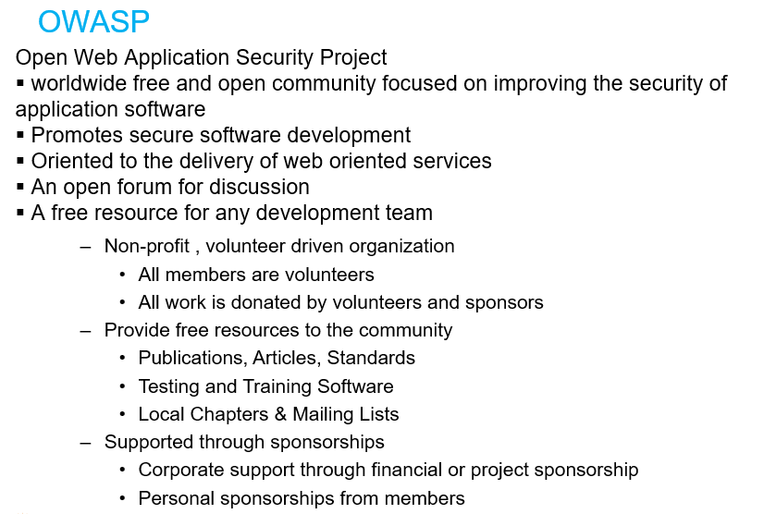

Slide 8
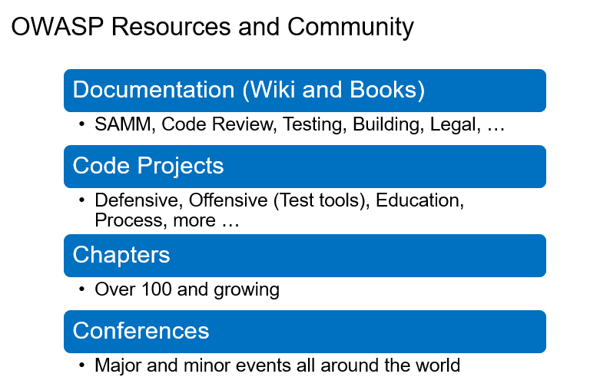

Slide 10
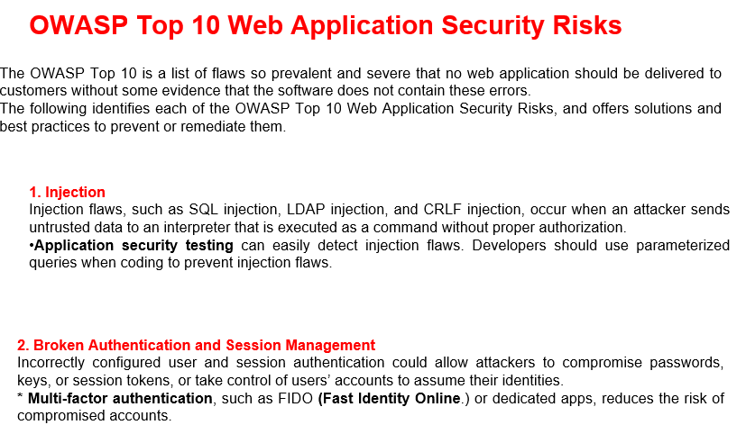

Slide 11
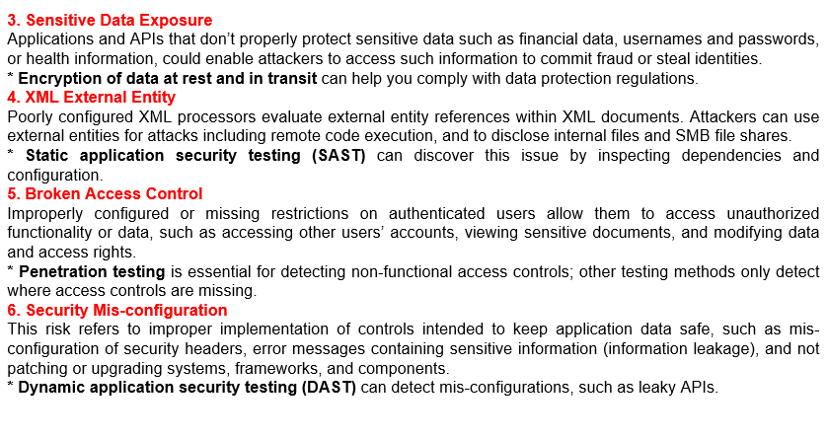

Slide 12
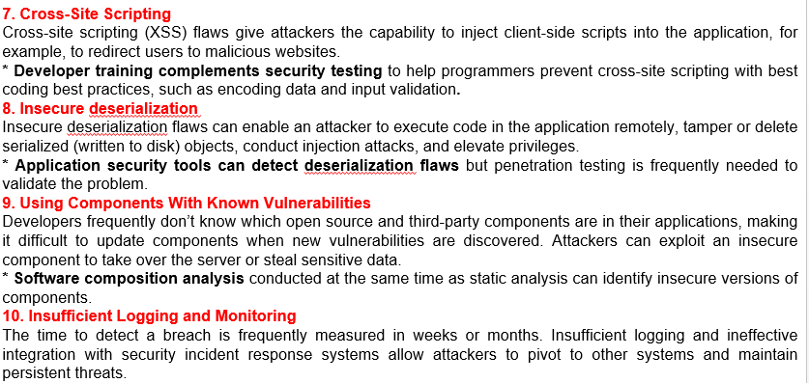

Slide 13
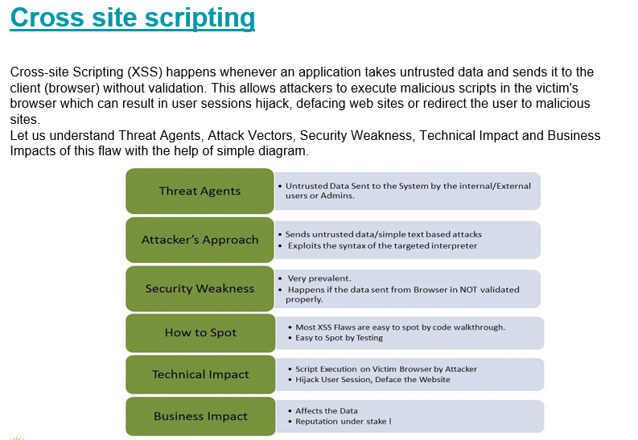

Slide 19
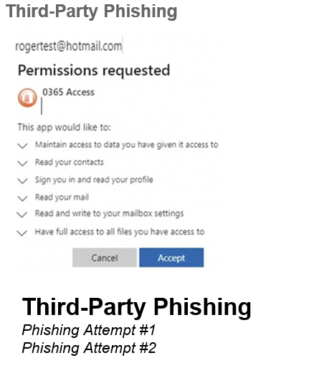

Slide 20
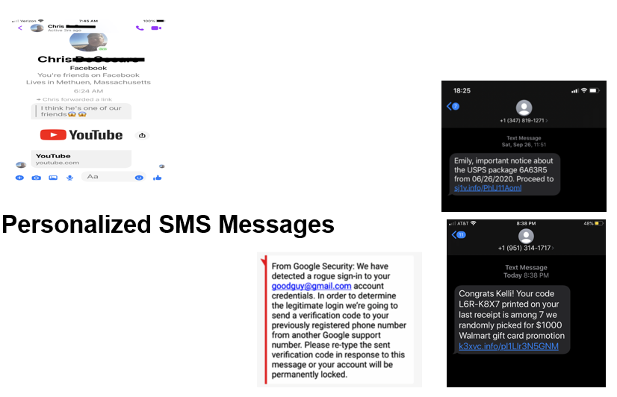

Slide 24
Link for Feedback
https://forms.gle/3r7zFHv1ALcMGsKT8

